Slide 1
Attendance Log api
Team MachineLearners

Slide 2

Meet The team
Tirth Gaurang Shah
Deep Jigneshkumar Ka Patel
Mayurkumar Patel
Anushka Vaibhav Rodi

Slide 3

Project Description
This project is a cloud-based attendance management system deployed on Microsoft Azure, harnessing the power of cloud computing and artificial intelligence. It integrates a front-end application and a dedicated face-recognition module, each hosted on separate Azure virtual machines (VMs), to offer a robust and scalable solution for real-time attendance tracking.

Slide 4


What does it do?
Front-End Server: Hosted on an Azure VM, this component serves as the user interface of the system. It captures live camera feeds from client-side devices, providing an interactive platform for users to manage attendance records and add new users to the system.
Face-Recognition Module: Deployed on a separate Azure VM, this module is the core of the system. It employs advanced face recognition algorithms to analyze frames from the camera feed, identifying individuals in real-time.

Slide 5
Project Functionality
Live Client-Side system Camera Feed Access for Attendance Capturing.
Storing Attendance log in Postgre SQL database.
Front-end for:
Viewing the logs
Adding user in the database and training the model (Automated)
Deleting a User
Reverts the frames with identified user
Back-end/API:
Face-Recognition model deployed with Flask for proper interaction with the React App.
Postgre SQL for maintaining logs and image data of users.

Slide 6

Project Demonstration
What we implemented v/s
What we intended to implement.

Slide 7
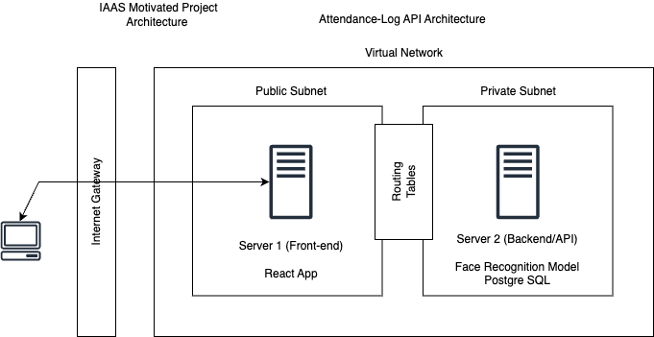
Project Architecture

Slide 8
Project Cost
Daily Cost: $4.61
Subject to change based on Usability
Components used: 2 Virtual Machines
1 Domain

Slide 9

Project Conclusion
This Azure-based attendance management system represents a cutting-edge integration of cloud computing and AI for real-time attendance tracking and management. Its modular architecture, coupled with the power of Azure's cloud services, makes it a scalable, efficient, and highly adaptable solution for modern attendance management needs.

Slide 10
Future Works
There is always scope for improvement:
Login Page, better UI.
More Structed and segregated architecture for better scalability.
Adding more features to the API.
Making it more cost efficient.
And using more accurate and lighter model for training.

Slide 11
Thank you!

